Slide 1
GOLDEN TESTER FRAMEWORK FOR
J1939-91C CYBERSECURITY
Mark Zachos, President, DG Technologies Inc.
Prakash Kulkarni, Ph.D., Director, DG Technologies Inc.

Slide 2
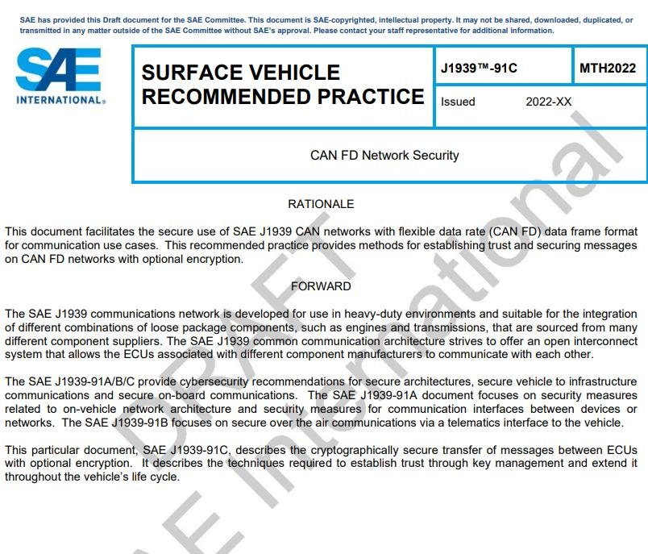
J1939-91C Approach
Challenges
100% Security is Not Possible
We are protecting critical infrastructure
Goals
Make it too expensive (time/money) to
make attacks worthwhile
Set a high bar
Key Concepts in J1939-91C
Node Authentication
Secure Key Generation, Rekeying
Network Formation
Data Integrity, Data Freshness
Insecure, Authentic and Confidential
messages

Slide 3
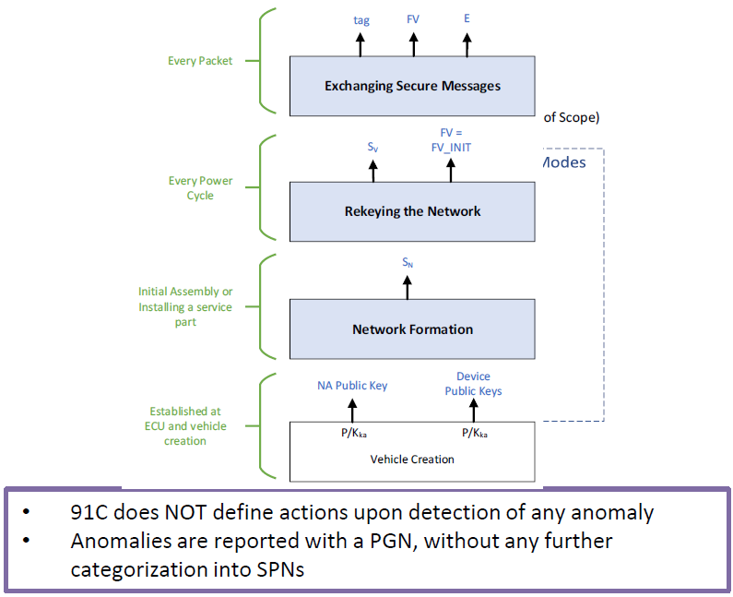
J1939-91C Protocol Overview
Operation Modes:
Vehicle network has one Network Leader NL
Certificate Authority CA (can be OEM) issues
certificates to all modules
Network key SN is created at first Power ON (N)
Normal Operation sequence
Carryover network key, SN
At power on:
        - address claim, then Rekey R to create Sv
        - Move to E to allow J1939 network messages
Edge cases can lead to
Repeat of Network Formation to create new SN
A module being dropped from network (in R)
Reverting back to ‘R’ from ‘E’
A time window with two valid session keys

Slide 4
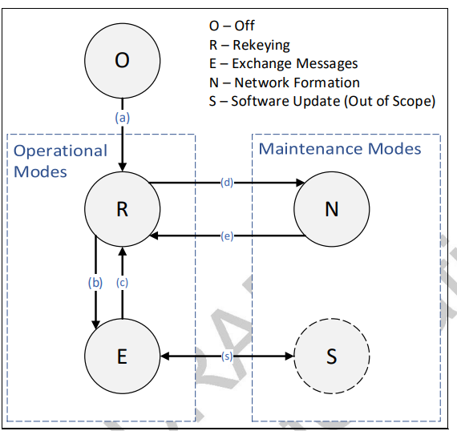
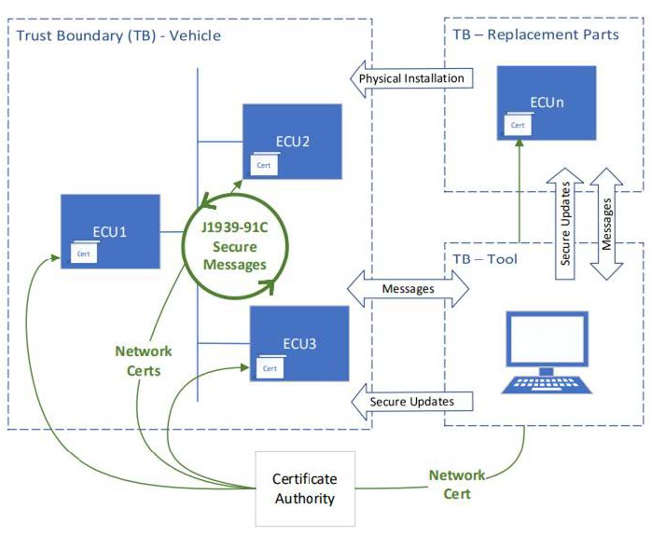
J1939-91C Scope, State Machine

Slide 5
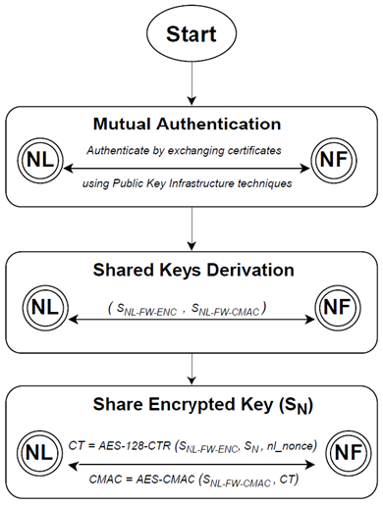
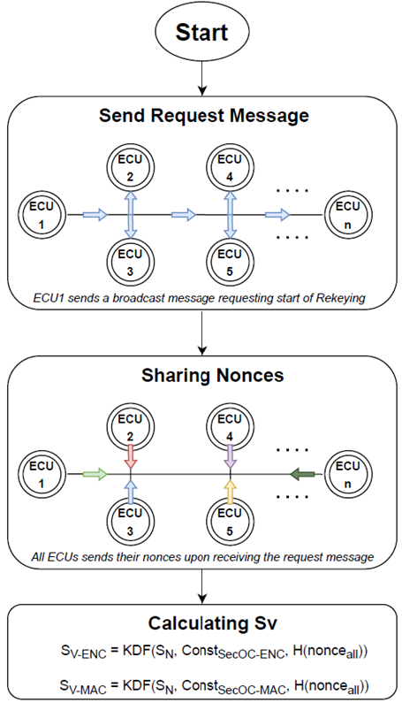
J1939-91C Network Formation, Rekeying

Slide 6
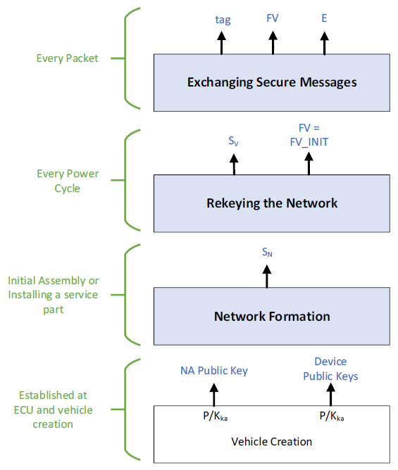
Rekeying

Slide 7
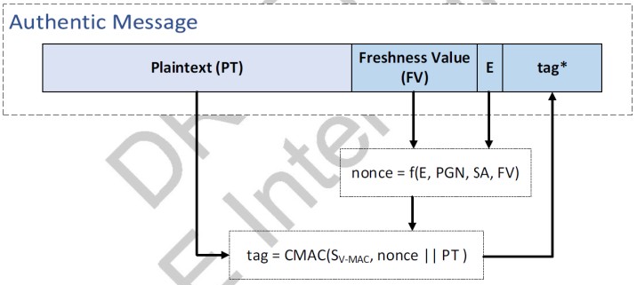
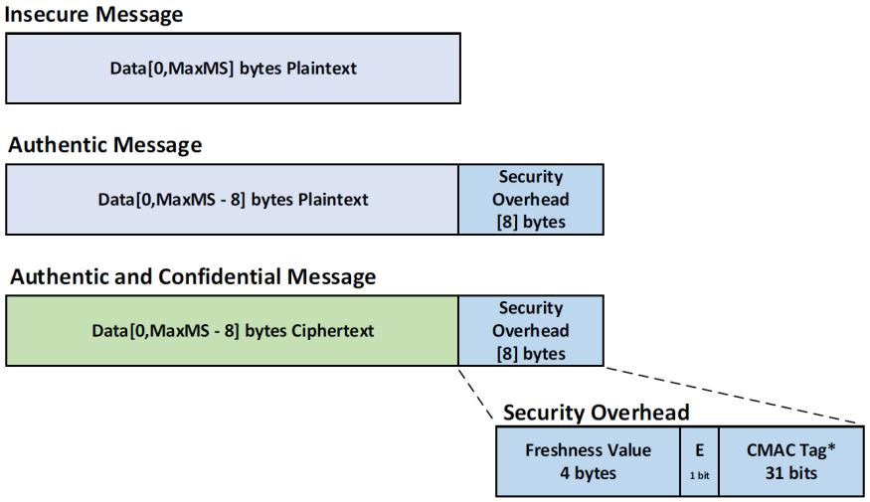
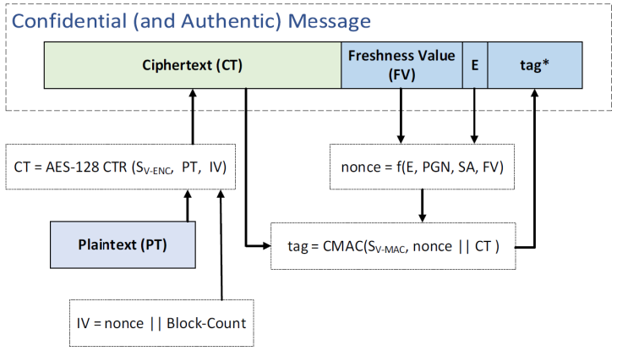
J1939-91C Message Types

Slide 8
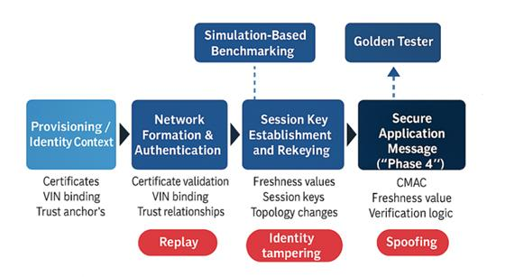
SAE J1939-91C Protocol Lifecycle

Slide 9
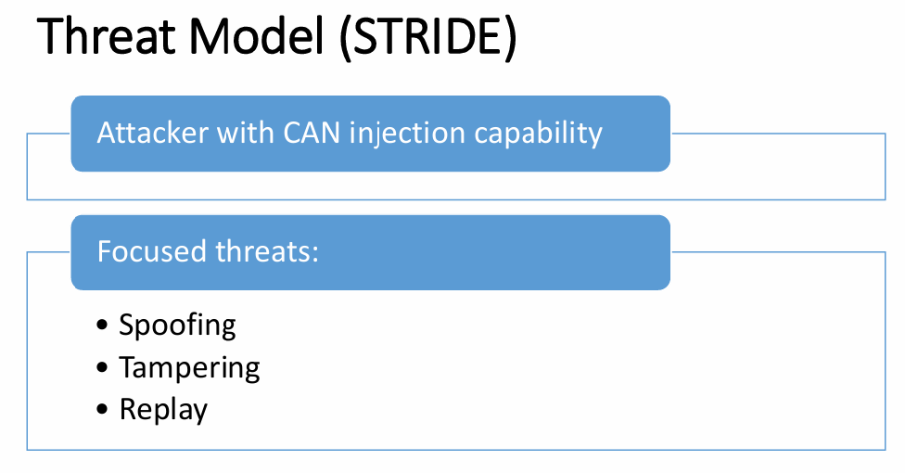
SAE J1939-91C Protocol Validation Artifact Mapping

Slide 10
Test Coverage
Network Formation
Announce Leader
Join Request
Certificate + VIN validation
X25519 → Session Key
Rekeying
Trigger conditions
Timing constraints
Forward security concept
Secure Message Exchange
CMAC input structure
FV usage
Tag truncation
Acceptance/rejection
Certificate/VIN Tampering
VIN mismatch behavior
Session termination
Return to Network Formation

Slide 11
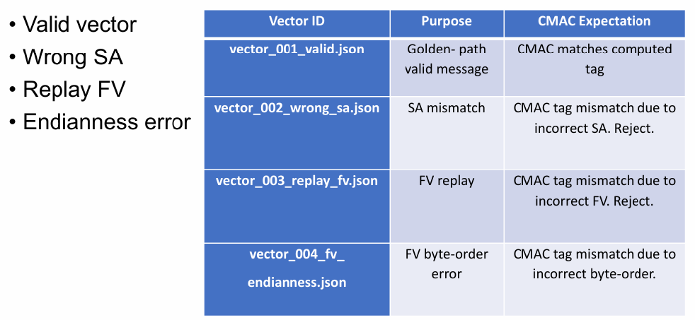
Example Test Vectors

Slide 12
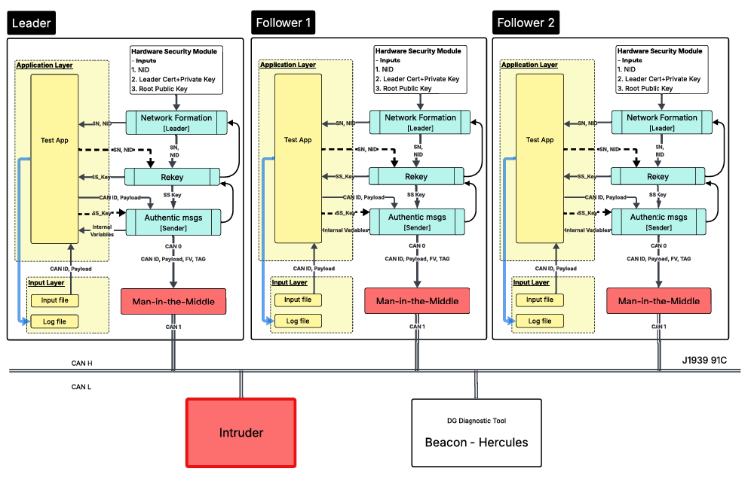
SAE J1939-91C Protocol Simulation Environment

Slide 13
SAE J1939-91C Protocol Simulation Environment

Slide 14
J1939-91C – DG Golden Tester
Tester Objectives
• Test fidelity of customer’s 91C implementation
• Suitable for both Leader and Followers
• Provide simulation environment to test
– fidelity of protocol implementation
– Cyber-resiliency
Test framework enables
• Black Box Testing – external attack vectors
• White box testing – with customer
Collaboration
Suite of test applications for
• Unit Testing
• All protocol modes - O, R, E, N
• Transitions between modes
• Cyber-resiliency testing
• Man-in-the-Middle
• Spoofing attacks
TEST MATRIX
Authentic Messages
Nominal Operation
Edge Cases
Intruder (External Attacks)
Rekey
Nominal Operation
Edge Cases
Intruder (External Attacks)
Rekey-Exchange Messages Transitions
Nominal Operation
Intruder (External Attacks)
Network Formation
Nominal Operation
Edge Cases
Intruder (External Attacks)
Network Formation - Rekey Interactions
Nominal Operation
Edge Cases
Intruder (External Attacks)

Slide 15
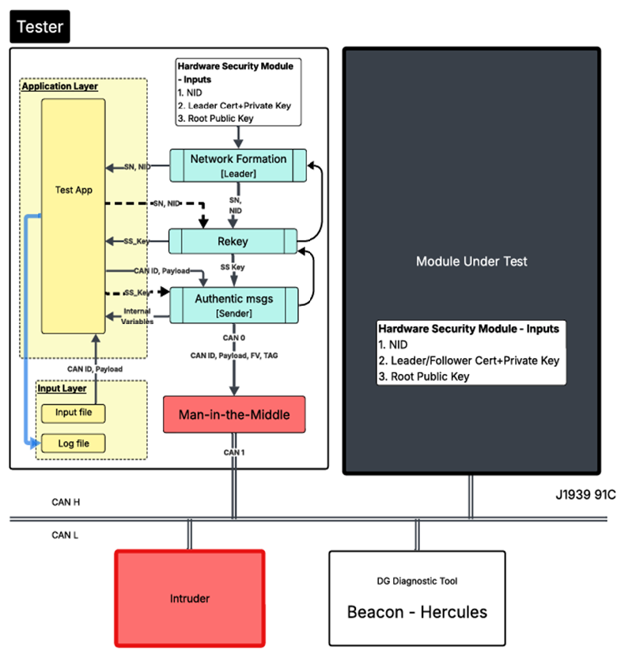
J1939-91C – DG Golden Tester
⮚ Jointly define test parameters
♦ Module role: Leader/Follower
♦ Certificate, Keys, Module J1939 SA
♦ Test bench
⮚ Customer provides
♦ Physical module
♦ Module-specific J1939 messages for testing
⮚ DG
♦ Integrate module on test bench
♦ Set up simulation parameters
♦ Conduct testing
• Unit tests for nominal, edge cases
• Cyber-attacks: MITM, Spoofing
♦ Provide test report
• Pass/Fail for all tests
• Cyber-resiliency score

Slide 16
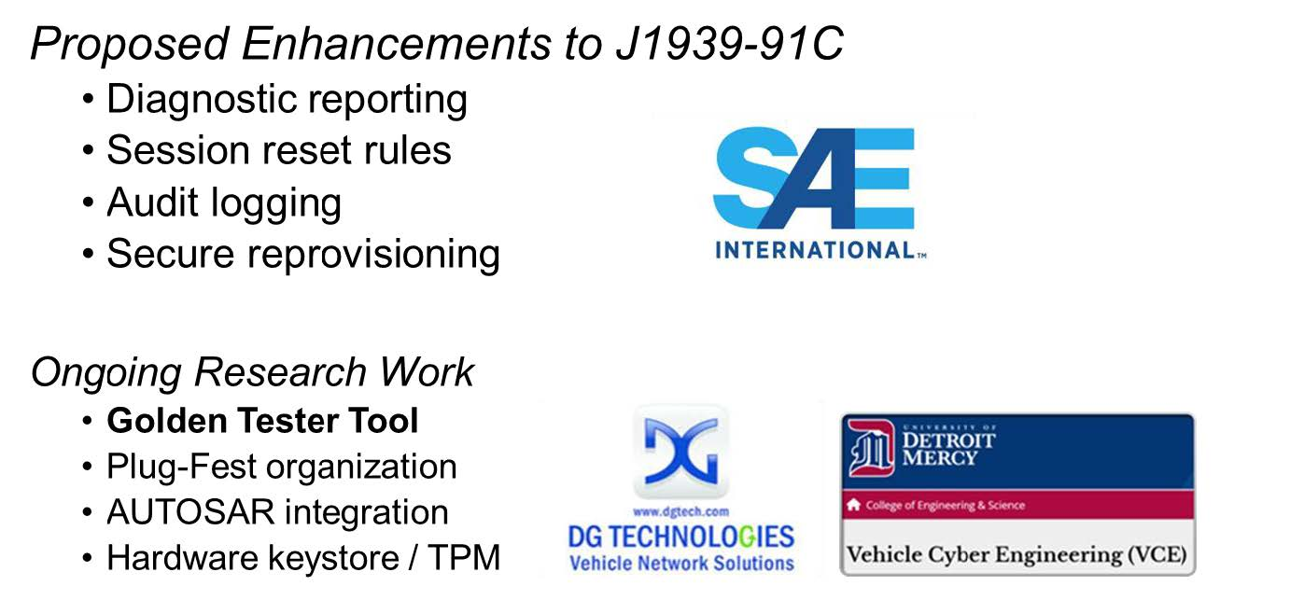
J1939-91C – DG Developments

